Slide 1
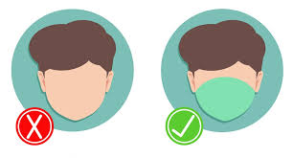
Face Mask Detection Using Machine Learning
Submitted By:
Aqsa Bibi
Tayyba Salamat
Sobia Nasir
Sundus Javed

Slide 2
Introduction
Face detection is a trending topic in computer vision for the past few years.
Face mask detection is a subset of object recognition that uses image processing algorithms. Digital image processing may be divided into two broad categories: classical image processing and deep learning-based image analysis. As opposed to classical image analysis, which uses complex formulas to recognize and interpret pictures, deep learning-based approaches utilize models that mimic the workings of the human brain.
Deep learning-based approaches for object identification and imagery analytics have been increasingly popular over the years. These technologies in the field of machine learning make our lives easy and provide a solution to a complex problem like coronavirus, where wearing a mask is necessary.
To address the problem of face mask recognition in facial images, we propose to use the DNN model. This model helps us recognize masked and non-masked people through a live video stream, where there are crowded places like schools, hospitals, banks, shopping malls, etc.
The goal of this study is to identify face masks from facial photographs.

Slide 3
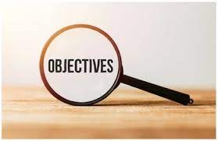
Objectives
To study the face recognition and detection technique.
To design a system that can detect faces in real-time.
Stimulate the Machine Learning algorithms and obtain the result using OpenCV with python.

Slide 4
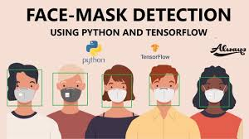
Tool and Techniques Used
These are tools and techniques used in project to get the best and most accurate results:
Python
Visual Studio (VS) Code
Tensor flow
Mobilenet_v2 model
DNN (Deep Neural Network) Model
Keras
OpenCV
Numpy
Sklearn
Matplotlib
Operating system

Slide 5
Proposed System
We proposed DNN deep neural network model consisting of seven layers.
Firstly, it detects human faces. Later on, it uses a lightweight image classifier to classify the faces which are detected at the first stage as either mask or no mask faces and draw bounding boxes around them along.
By using imutils we can integrate the live video cam to detect with or without masks person.

Slide 6
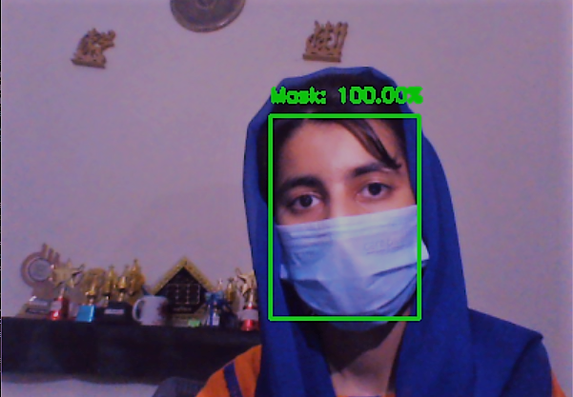
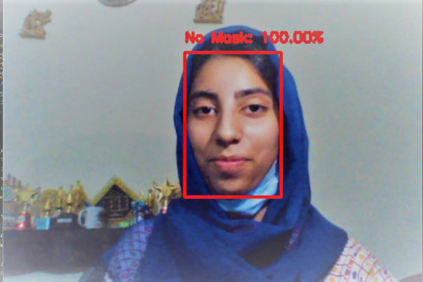
Real Time Outputs
Outputs of face mask detector from web cam are:
With Mask Without Mask

Slide 7
Conclusion
This model gives us the accurate result on the single and multiple faces with or without masks gives accurate result.
It works on any mobile device by switching on the video stream. The face detection algorithms were thoroughly studied taking a number of tests and varying the condition and image.
We learnt a lot about the vast collection of image processing module in opencv.

Slide 8
YouTube Video Link
https://www.youtube.com/watch?v=IAyNBMGqvBY

